Slide 1


Improving Cost Estimation and Project Planning
A Data-Driven Approach for Contract-Based Furniture Projects
THAKUR VISHALKUMAR VINOD
IITM Online BS Degree Program
Indian Institute of Technology, Madras

Slide 2




Slide 2: Executive Summary
Project Overview
Project Goals
Data-driven approach for The Furniture Master Interiors
Develop accurate cost estimation models
Analysis of 25 completed projects (Jan-Jun 2025)
Improve project timeline management
Focus on cost estimation accuracy and timeline management
Enhance profitability and customer satisfaction
Key Challenges
Systematic cost underestimation in quotations
Average Cost Overrun
Frequent project delays affecting profitability
6.76%
Impact on customer satisfaction and business growth
Total impact: ₹944,491 across all projects
Average Project Delay
3.8 days
Maximum delay: 7 days

Slide 3


Slide 3: Problem Statement
Inaccurate Cost Estimations
Project Delays
6.76%
88%
3.8
7
Average Cost Overrun
Projects Over Budget
Average Delay (Days)
Maximum Delay (Days)
₹944,491 total profit erosion across analyzed projects
Longer projects accumulate more delay days (R²=0.86)
Quoting process lacks risk-adjusted pricing
Main causes: supplier delays, client changes, labor shortages
Direct impact on profit margins (40-68% reduction in net
profitability)
Direct impact on customer satisfaction and business reputation

Slide 4












Slide 4: Methodology
Data Collection
Analysis Approach
6-month period (Jan-Jun 2025)
Data cleaning: standardizing units, correcting spellings
25 completed projects from The Furniture Master
Descriptive statistics: mean, median, standard deviation
Sources: quotations, purchase records, bills, site reports
Correlation analysis: relationships between variables
Cross-verified with physical invoices and delivery slips
Trend analysis: patterns in cost overruns and delays
Excel Analysis
Python Modeling
PivotTables, charts, conditional formatting for
business insights
Regression models, statistical tests, data visualization

Slide 5

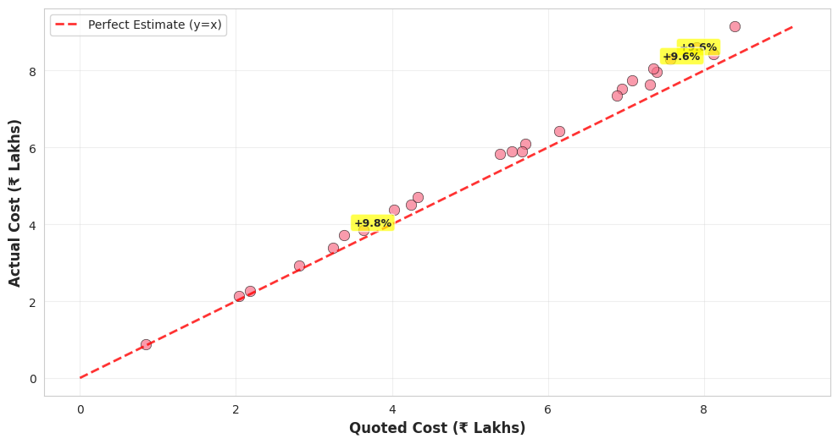

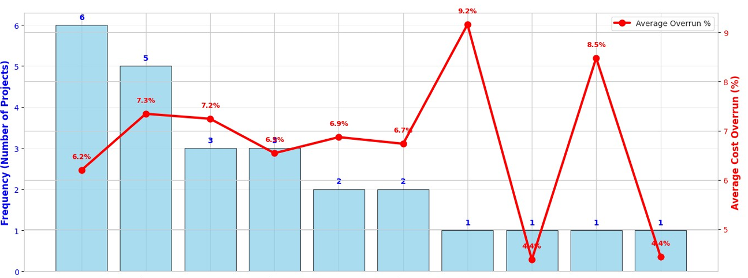

Slide 5: Key Findings - Cost Analysis
Quoted vs. Actual Cost
6.76%
₹944,491
Average Cost Overrun
Total Financial Impact
Figure no. 1
Cost Overrun Distribution
Figure no. 1
Figure no. 2
Key Insight
Business Impact
Only 3 projects (12%) stayed within budget, while 22 projects (88%) exceeded quoted costs
For every ₹100,000 quoted, the actual cost is ₹106,760, creating a systematic profit gap

Slide 6


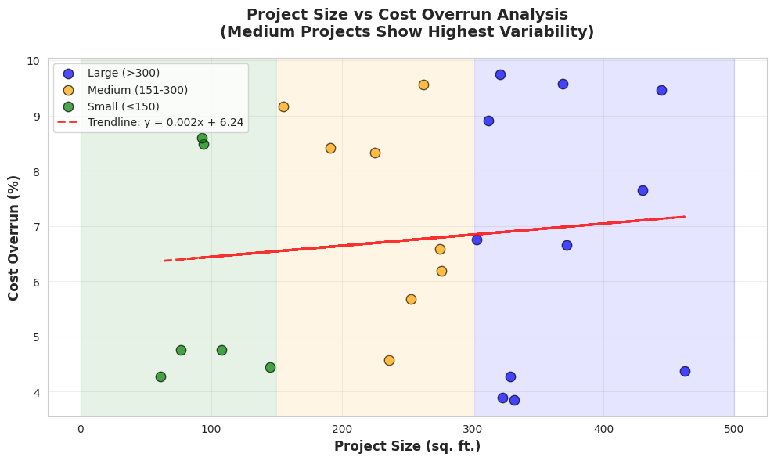




Slide 6: Key Findings - Project Size Impact
Project Size vs. Cost Overrun
Small Projects (≤150 sq.ft.)
5-6% average overrun
Most predictable
Medium Projects (150-300 sq.ft.)
7-8% average overrun
Highest volatility
Large Projects (>300 sq.ft.)
6-7% average overrun
Moderate predictability
Figure no. 3
Key Insight
Business Recommendation
Medium projects (151-300 sq.ft.) show the highest volatility in cost overruns, making them the most unpredictable category
Apply size-based buffers: Small (5-7%), Medium (8-10%), Large (6-8%) to account for varying risk profiles

Slide 7


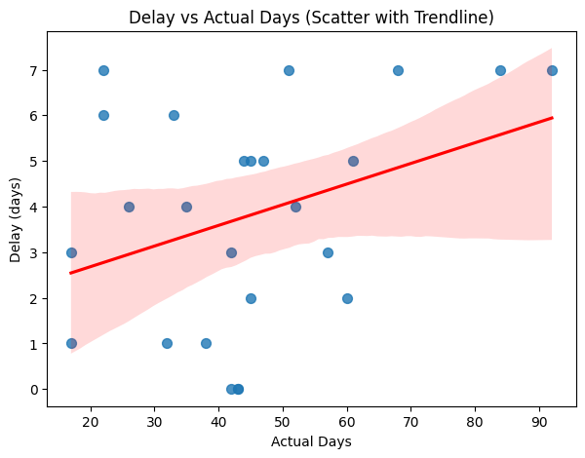



Slide 7: Key Findings - Delay Analysis
3.8
7
Main Causes of Delays
Average Delay (Days)
Maximum Delay (Days)
Supplier Delays
Late delivery of plywood, laminates, fevicol
Project Duration vs. Delay
Client Changes
Extra cabinets, design modifications
Labor Shortages
Especially during festival seasons
Design Revisions
Mid-project changes requiring rework
Figure no. 4
Key Insight
Business Recommendation
Strong correlation (R²=0.86) between project duration and absolute delay days
Apply proportional timeline buffers (5-10% of estimated duration)

Slide 8

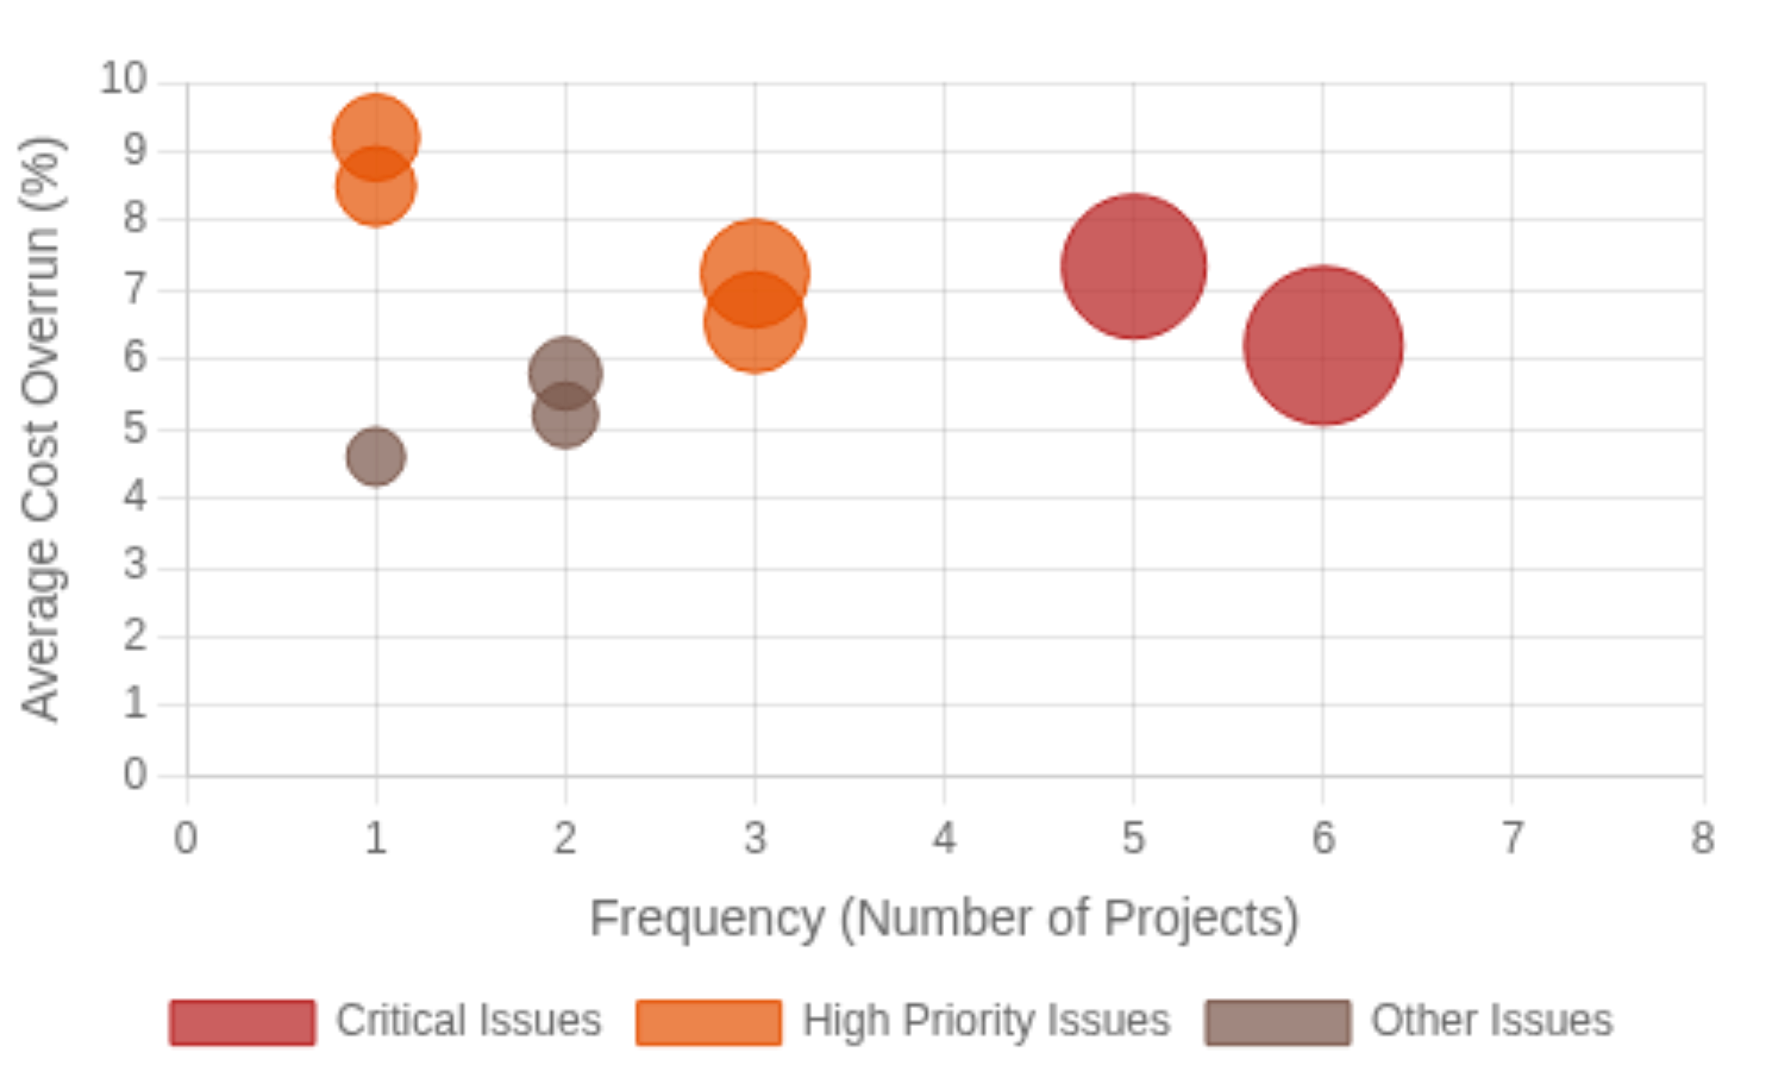
Slide 8: Root Cause Analysis
Frequency vs. Impact Analysis
Top 3 Issues by Financial Impact
1
Client-Requested Changes
₹221,141 total impact | 6 projects | 6.2% avg overrun
2
Supplier Delays in Plywood
₹195,630 total impact | 5 projects | 7.34% avg overrun
3
Labor Shortages (Festival Season)
₹122,413 total impact | 3 projects | 7.2% avg overrun
Figure no. 5
Key Insight
Strategic Opportunity
High-frequency issues create the largest cumulative financial damage, even when individual impact is moderate
Addressing the top 3 issues would mitigate ₹539,184 (57%) of the total overrun amount

Slide 9







Slide 9: Recommendations
Data-Driven Quoting Buffer
Formal Change-Order Process
Supplier Management
Default: 7%
Written change requests
Negotiate SLAs for lead times
Size-based adjustments
Priced change orders
Maintain safety stock
Small: 5-7%
Client sign-off required
Build backup vendor list
Medium: 8-10%
Large: 6-8%
15% premium after week 2
2% penalty for delays
Target: Cost Overrun
Target: Change Orders
Target: On-Time Delivery
≤ 2%
≤ 30% of projects
≥ 90%
Flexible Labor Planning
Proportional Timeline Buffers
Treat Time as Cost
Trusted subcontractor roster
Replace fixed 2-day buffers
Track delay costs in real-time
Pre-book for festival seasons
Add 5-10% of duration
0.13% cost per delay day
Cross-train staff
Higher for medium projects
Early warning system
Peak season surcharge
Monitor daelays weekly
Delay as cost overrun indicator
Target: Average Delay
Target: Buffer Coverage
Target: Profit Margin
≤ 2 days
≥ 85%
+4-5% improvement

Slide 10




Slide 10: Expected Outcomes
Improved Profitability
Better Customer Satisfaction
Immediate Profit Improvement
Reduction in Profit Erosion
Reduction in Delays
On-Time Delivery Rate
4-5%
40-68%
50%
85%
Data-driven buffers for accurate cost estimation
Realistic timelines with proportional buffers
Cost overruns reduced from 6.76% to ≤2%
Clear change-order process with client approval
Recovery of ₹539,184 from top 3 issues
Transparent pricing reduces surprises
Competitive Advantage
Business Growth
Market Share Growth
Referral Business Increase
Annual Revenue Growth
Project Capacity
15%
30%
25%
2x
Reputation for reliable delivery in Pune market
Scalable operational processes
Confidence to handle larger projects
Improved resource allocation
Stronger supplier relationships
Foundation for sustainable expansion

